Slide 1
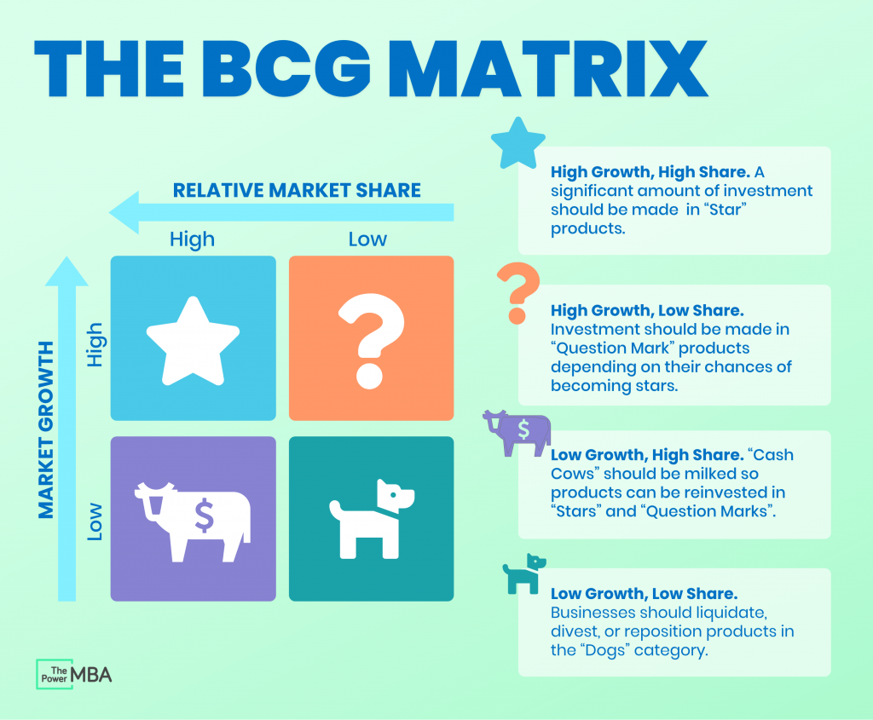
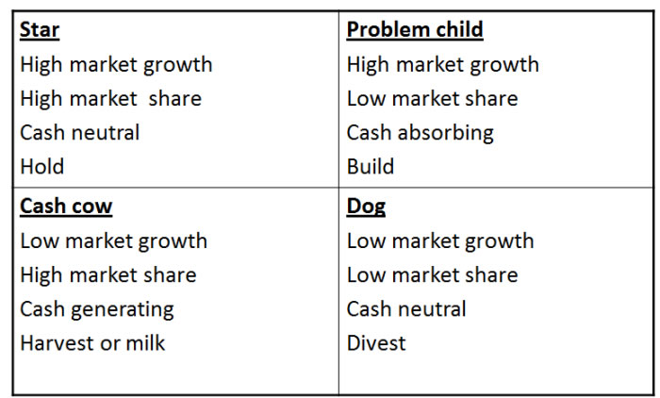
Boston Consulting Group (BCG) matrix
The Boston Consulting Group (BCG) matrix is a strategic management tool that helps businesses to evaluate their product portfolio based on two dimensions: market growth rate and relative market share. It is named after the consulting firm that developed it, the Boston Consulting Group.

Slide 2
Boston Consulting Group (BCG) matrix
Stars: High-growth, high-market-share products or businesses that generate a large amount of revenue and profits. Stars require significant investment to maintain their growth, but they have the potential to become cash cows in the future.
Cash cows: Low-growth, high-market-share products or businesses that generate a steady stream of revenue and profits. Cash cows require less investment to maintain their position in the market, and they generate a lot of cash that can be used to invest in other areas of the business.
Question marks: High-growth, low-market-share products or businesses that are not yet established in the market. Question marks require significant investment to grow and gain market share, but they also have the potential to become stars or cash cows in the future.
Dogs: Low-growth, low-market-share products or businesses that generate little revenue or profits. Dogs do not require significant investment and often have low profit margins, making them unattractive investments.

Slide 3
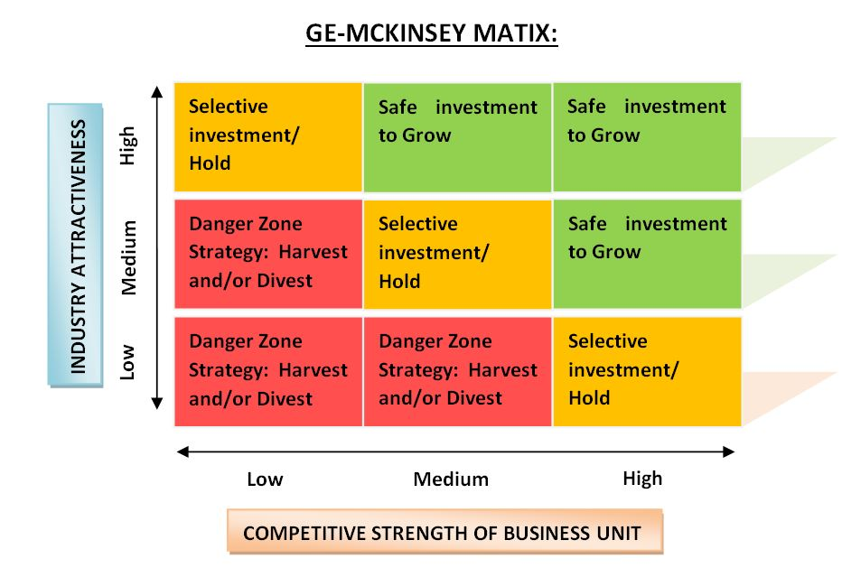
GE McKinsey matrix
The GE McKinsey matrix is a strategic management tool used to evaluate a company's business portfolio. The matrix was developed by General Electric in the 1970s in collaboration with McKinsey & Company.
The GE McKinsey matrix evaluates a company's business units based on two dimensions: industry attractiveness and business unit strength. Industry attractiveness refers to the overall potential of the industry, including market growth rate, market size, profitability, and competition. Business unit strength refers to the company's ability to compete in the industry, including factors such as market share, brand strength, product quality, and financial strength.

Slide 4
High
Medium
Low
Which one is
Invest
Protect
Harvest/ divest
Industry Attractiveness
Market size and potential for growth
Buyer and supplier power
Threats of new entrance
High Medium Low
Competitive Strength of BU
Market share and growth
Profit Margin and manufacturing cost
Customers satisfaction
Customers retention and loyalty.

Slide 5
Medium investment/high return: These business units have strong business unit strength but lower industry attractiveness. Companies should consider investing in these units to improve their industry attractiveness and potential return.
Low investment/high return: These business units have high industry attractiveness but require little investment to maintain their position. Companies should continue to invest in these units to maximize their returns.
High investment/low return: These business units have weak business unit strength and low potential return. Companies should consider divesting or discontinuing these units.
Medium investment/low return: These business units have moderate levels of industry attractiveness but lower business unit strength. Companies should consider investing in these units to improve their business unit strength and potential return.
Low investment/medium return: These business units have weaker industry attractiveness but strong business unit strength. Companies should consider investing in these units to improve their industry attractiveness and potential return.

Slide 6
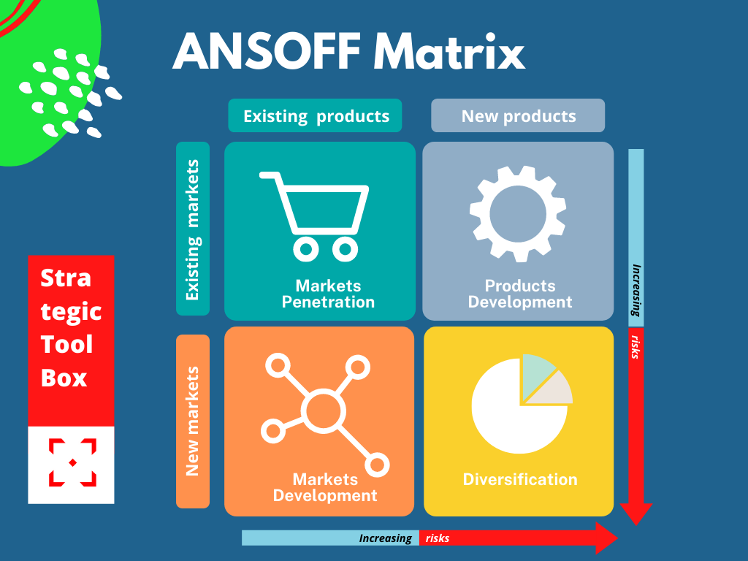
The Ansoff Matrix, developed by Igor Ansoff, is a strategic planning tool that helps businesses identify and evaluate various growth strategies. By analysing market penetration, market development, product development, and diversification, companies can make informed decisions to drive their growth and achieve long-term success.

Slide 7
Market Penetration:
Description: This strategic planning involves selling more of the existing products to the current market in order to increase the market share and sales within the existing market.
Process: Pricing strategies, promotions, advertising, product improvements, or enhanced customer service.
Market Development:
Description: This strategic planning involves introducing existing products to new markets through Expand the business by entering new geographical areas
Process: New distribution channels, targeting new customer segments, or entering international markets.
Product Development:
Description: This strategic planning involves developing new products for the existing market by Expand the product line to meet the needs of current customers and attract new ones
Process: Research and development, innovation, and creating variations or upgrades of existing products.
Diversification:
Description: This strategic planning involves entering new markets with new products.
Process: Acquisitions, partnerships, or launching entirely new products in new markets.

